Slide 1
DISARM Milestone 6 Second Semester
Debris In Space Autonomous Removal Mechanism
4/16/2021

Slide 2
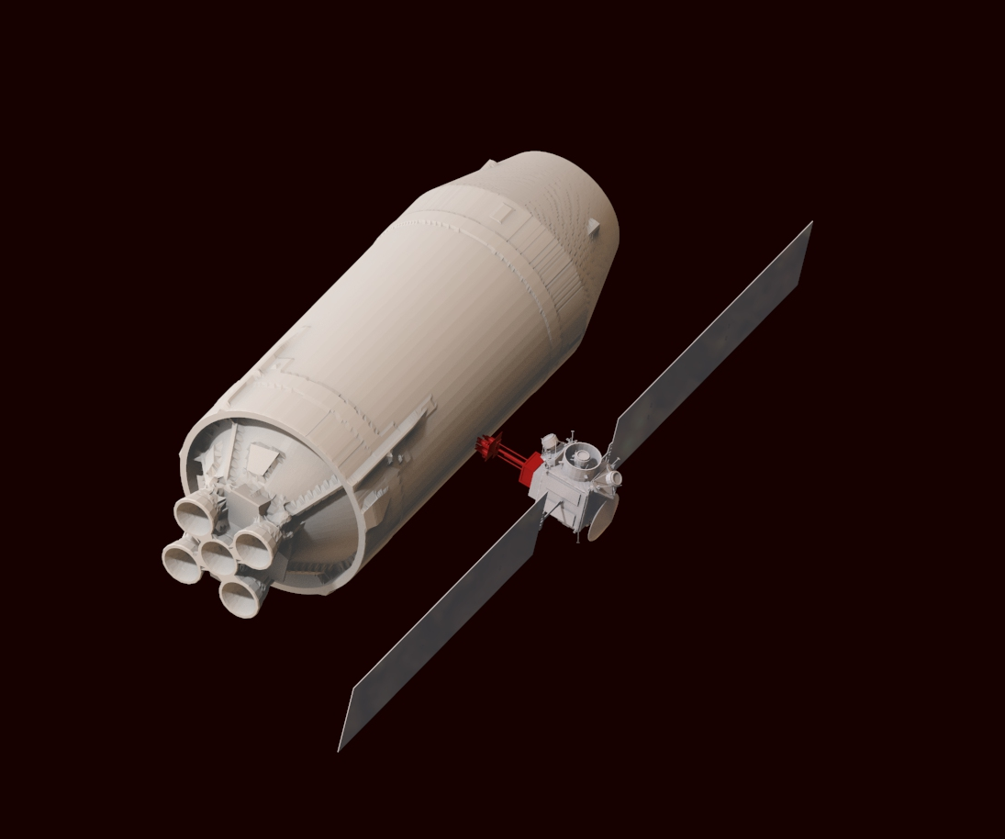
Content
MILESTONE TASKS
DEMO VIDEO
LESSONS LEARNED

Slide 3
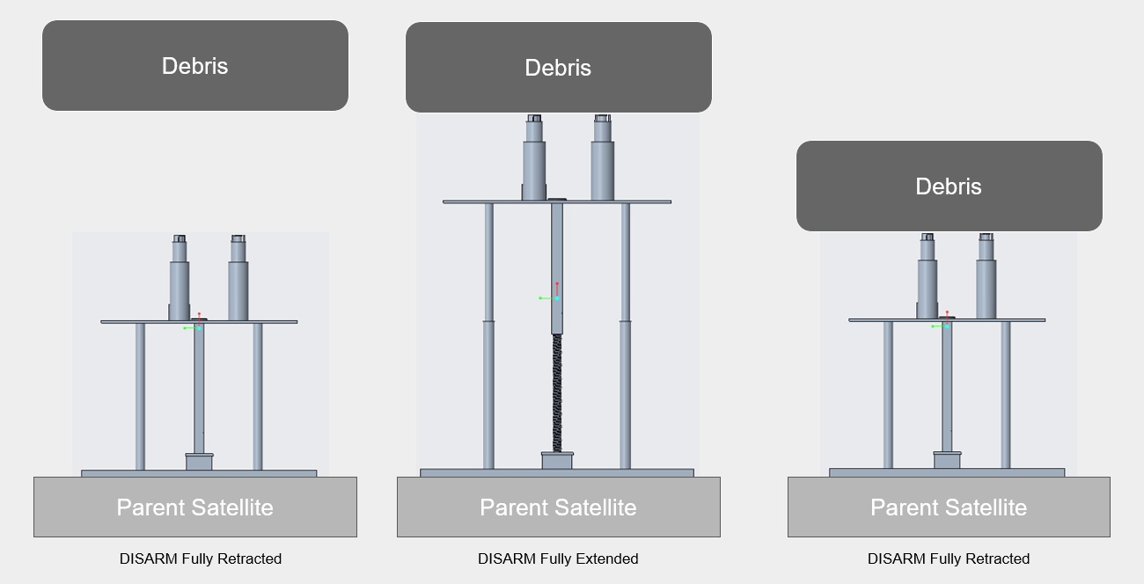
Client: Dr. Markus Wilde Advisor: Dr. Marius Silaghi

Slide 4
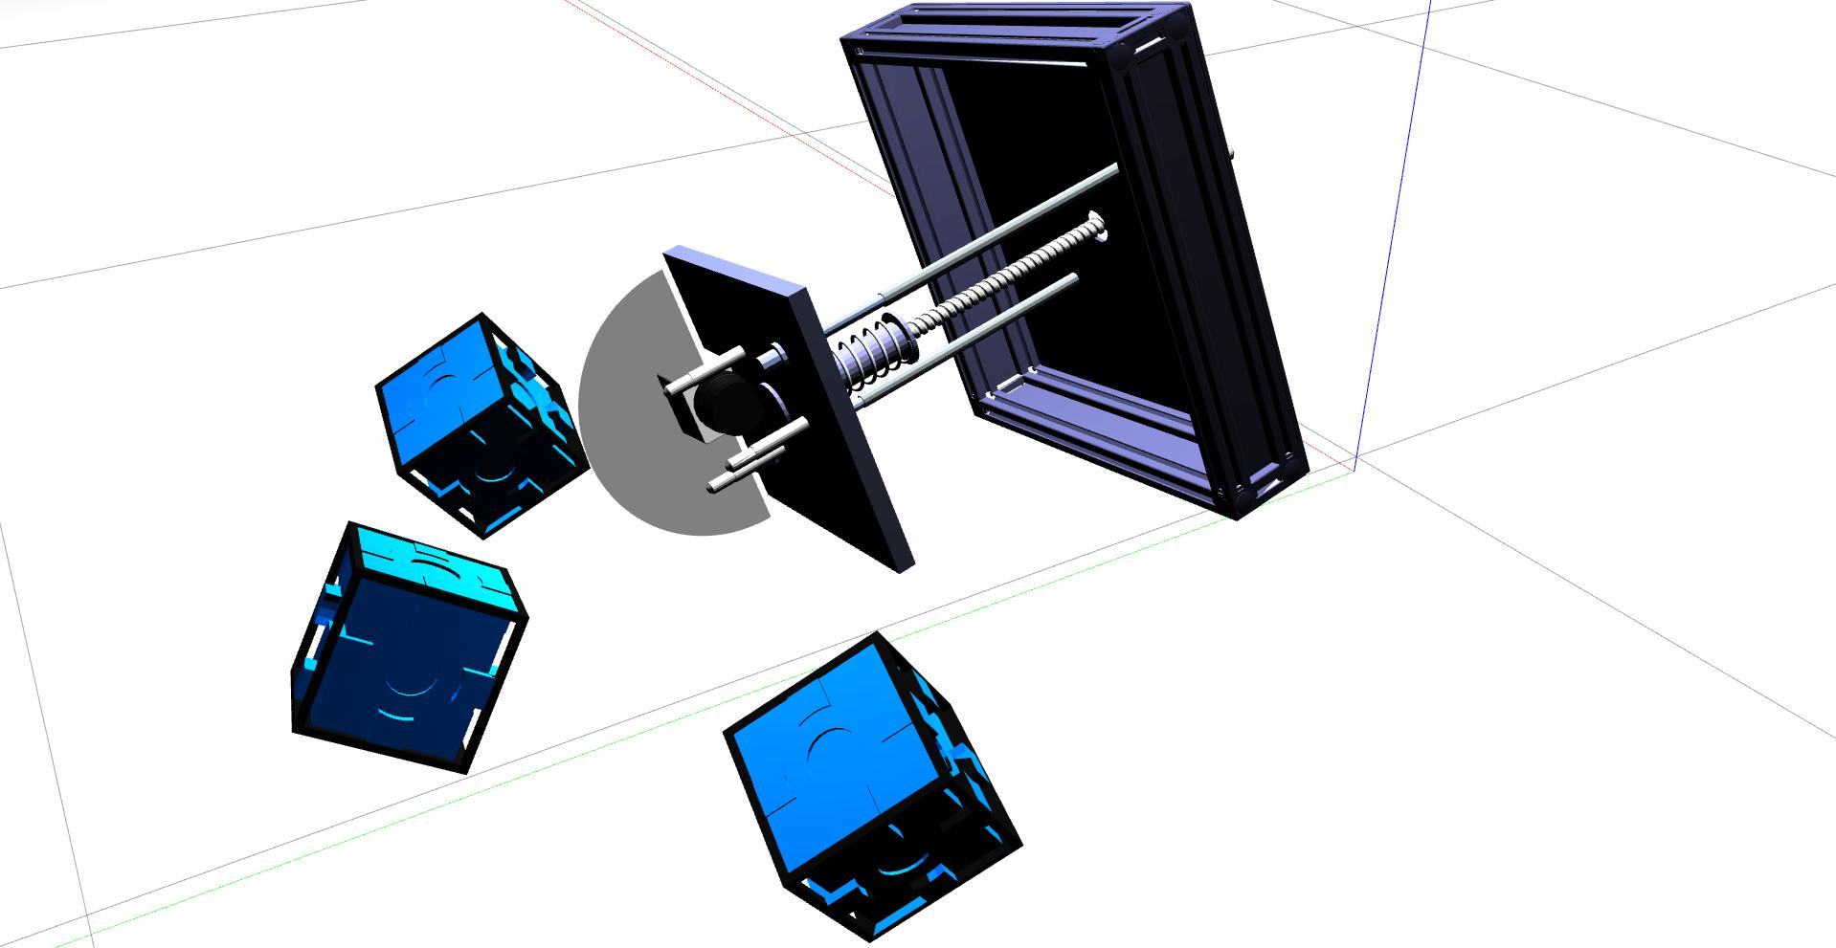
MILESTONE TASKS
1) Finish poster and e-book
2) Test Arduino Code
3) Finish Recording and Edit Demo Video

Slide 5
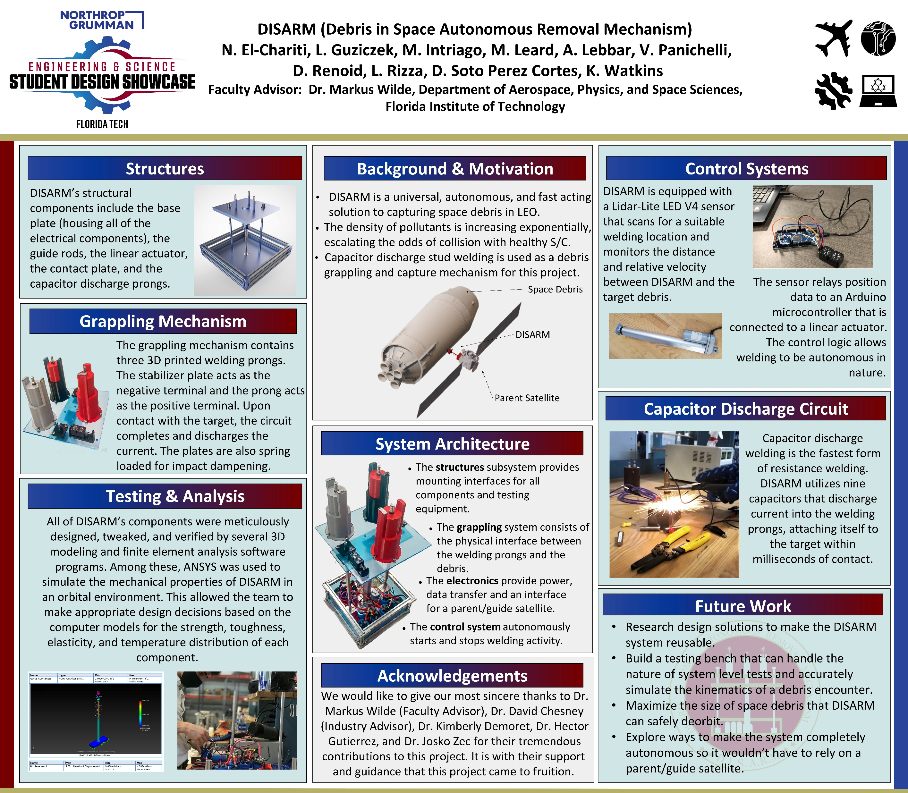
TASK 1 – Poster

Slide 6
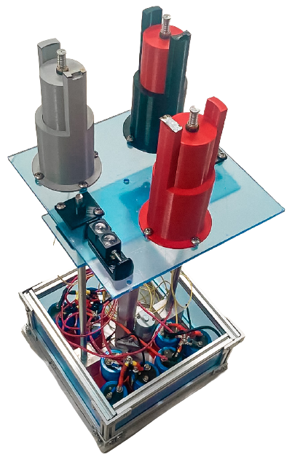
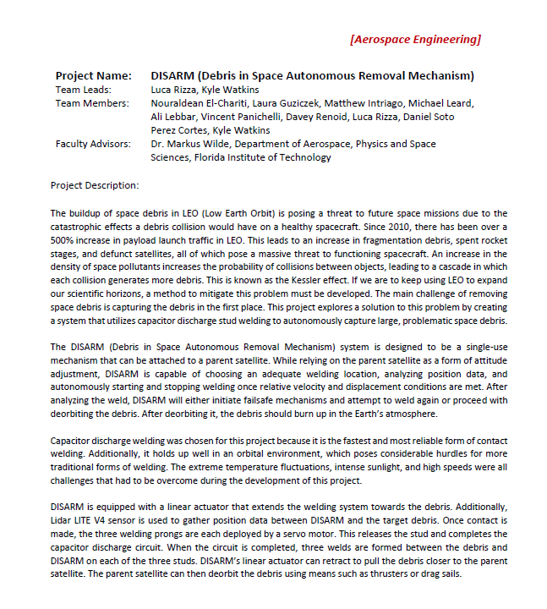
TASK 1 – Ebook Page

Slide 7

TASK 2 AND 3 – Demo Video
https://www.youtube.com/watch?v=66Hwhugrm3c&ab_channel=DISARM

Slide 8
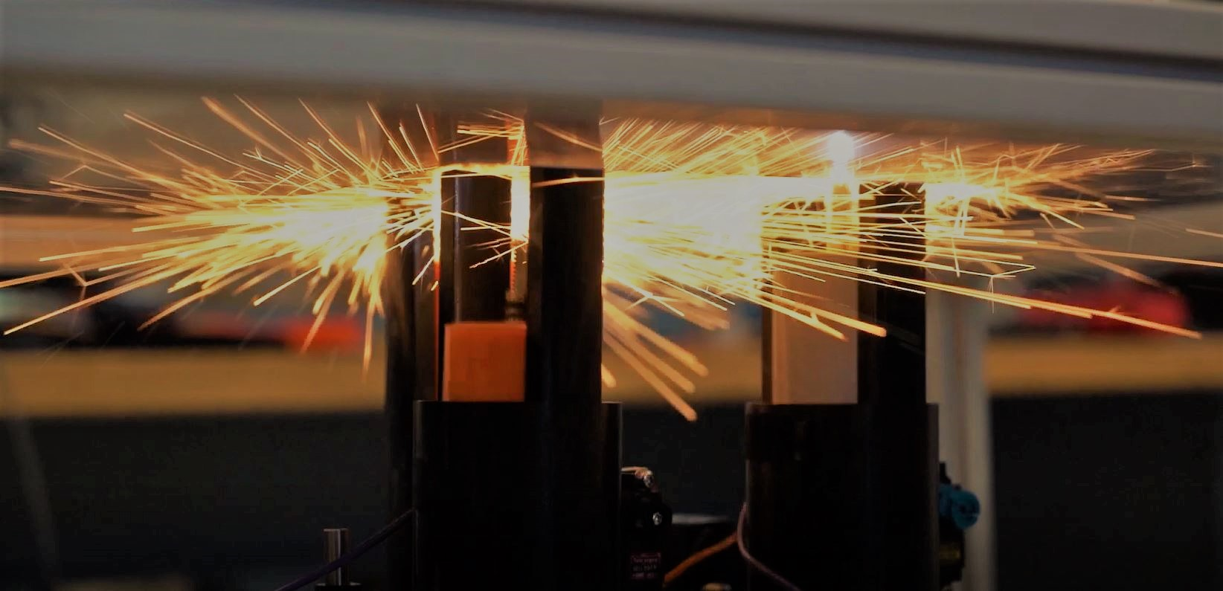
LESSONS LEARNED
Designing autonomous systems using ROS requires extensive knowledge. Most of the time throughout the project I spent learning ROS and Gazebo mechanics, only scratching the surface potential of the software. There are many improvements that can be made in the simulation due to this and hope that the project continues to be pursued after the 2021 showcase.

Slide 9
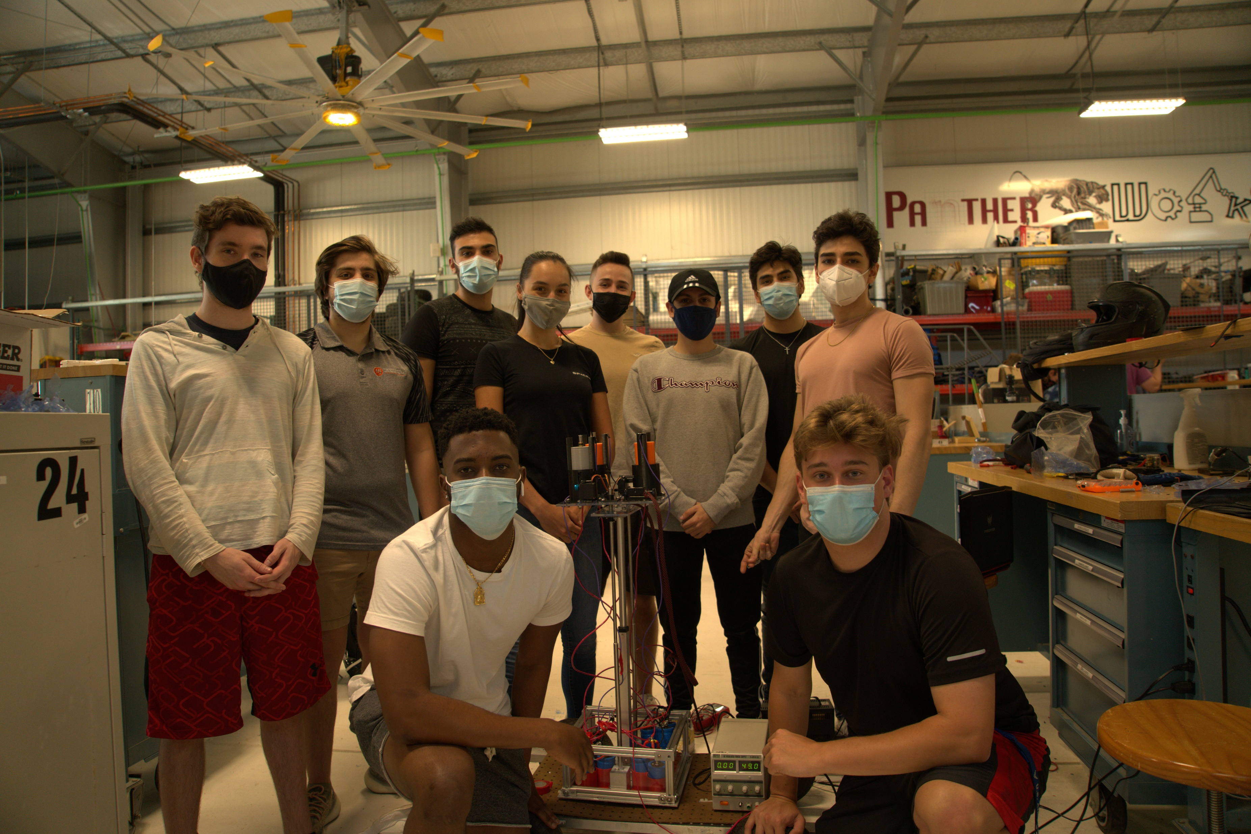

Slide 10
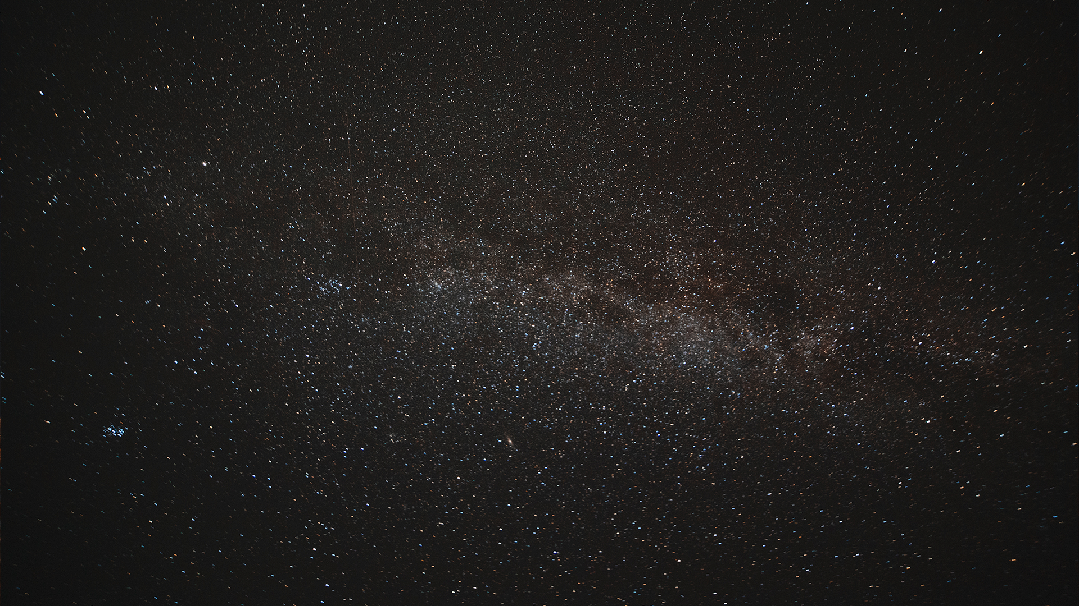

THANK YOU!
Any Questions?
Kyle Watkins, Project Manager
watkinsk2017@my.fit.edu
Luca Rizza, Systems Engineer
lrizza2017@my.fit.edu
Laura Guziczek, Engineer
lguziczek2018@my.fit.edu
Michael Leard, Engineer
mleard2017@my.fit.edu
Ali Lebbar, Engineer
alebbar2016@my.fit.edu
Davey Renoid, Engineer
drenoid2016@my.fit.edu
Matthew Intriago, Computer Science
mintriago2017@my.fit.edu
Vincent Panichelli, Engineer
vpanichelli2017@my.fit.edu
Daniel Soto, Engineer
dsotoperezco2017@my.fit.edu
Nouraldean El-Chariti, Engineer
nelchariti2017@my.fit.edu

